Slide 1


Stock Market Prediction
USING
Machine learning
Akshay R 1ST14CS010
Aravind B 1ST14CS023
Arun Kumar 1ST14CS025
Ashok S 1ST14CS027
Under the guidance of
Dr. T John Peter
Sambhram Institute of Technology
Department of Computer Science & Engineering

Slide 2
Abstract
Time series forecasting has been widely used to determine the future prices of stock, and the analysis and modelling of finance time series importantly guide investors’ decisions and trades
This work proposes an intelligent time series prediction system that uses sliding-window metaheuristic optimization for the purpose of predicting the stock prices
The system has a graphical user interface and functions as a stand-alone application.
The proposed model is a promising predictive technique for highly non-linear time series, whose patterns are difficult to capture by traditional models.

Slide 3

Introduction
Financial markets are highly volatile and generate huge amounts of data daily
It is the most popular financial market instrument and its value changes quickly
Stock prices are predicted to determine the future value of companies’ stock or other financial instruments that are marketed on financial exchanges
However, the stock market is influenced by many factors such as political events, economic conditions and traders’ expectation

Slide 4

What is Machine Learning
Machine Learning is the field of study that gives computers the ability to learn without being explicitly programmed
More formally, it can defined as,
A computer program is said to learn from experience E with respect to some class of tasks T and performance measure P, if its performance at tasks in T, as measured by P, improves with experience E
Example: playing checkers.
E = the experience of playing many games of checkers
T = the task of playing checkers.
P = the probability that the program will win the next game.

Slide 5

Machine Learning in Stock Prediction
The field of Machine Learning is vast and plays a key role in a wide range of critical applications.
The concept of Support Vector Machines (SVM) have advanced features that are reflected in their good generalization capacity and fast computation.
Predicting the stock market involves predicting the closing prices of a company’s stock for any given number of days ahead.
SVMs can be used to perform Linear Regression on previous stock data to predict the closing prices using Time series forecasting and other optimization algorithms

Slide 6

Existing Methods
Time series forecasting consists of a research area designed to solve various problems, mainly in the financial area
Support vector regression (SVR), a variant of the SVM, is typically used to solve nonlinear regression problems by constructing the input-output mapping function.
The least squares support vector regression (LSSVR) algorithm is a further development of SVR and its use considerably reduces computational complexity and increases efficiency compared to standard SVR.
The Firefly Algorithm (FA), which is a nature-inspired metaheuristic method, has recently performed extremely well in solving various optimization problems.

Slide 7
Disadvantages
The existing system focuses on the stock price market in Taiwan, but does not generalize for other markets worldwide.
The system does not allow the import of raw data directly
The existing system cannot be used to analyze multi-variate time series
Lastly, the system does not have a user-interface which can be distributed as a web app to users for personal use

Slide 8

Proposed System
To generalize the application of the existing system, our work uses the system to estimate other stocks in similar emerging markets and mature markets
The system can be extended to analyze multivariate time series data and import raw dataset directly
Profit can be maximized even when the corporate stock market is has lower value
The development of a web-based application has been considered to improve the user-friendliness and usability of the expert system.

Slide 9

Algorithms
LSSVR - Least Squares Support Vector Regression
The LSSVR algorithm is a further development of SVR by Suykens (2001) and involves equality instead of inequality constraints, and works with a least squares objective function. The LSSVR approach considerably reduces computational complexity and increases efficiency compared to standard SVM. LSSVR solves linear equations instead of a quadratic programming problem
FV - The Firefly Algorithm
The Firefly Algorithm (FA), which is a nature-inspired metaheuristic method, has recently performed extremely well in solving various optimization problems such as stock price forecasting and electricity price prediction. The standard FA was developed by modelling the behaviour of tropical fireflies. Notably, the smart firefly algorithm-based LSSVR has been demonstrated to be very effective in solving complex problems in civil engineering.

Slide 10
Architecture
Initialize Parameters
Select Training Set
Feature Scaling
Training Data
Firefly Algorithm
Optimal
Hyperparameters
LSSVR training model
Save Model
The regularization parameter and the sigma parameter of the RBF kernel is optimized by the Firefly Algorithm, which are used to train the LSSVR.
This method provides an optimal stock price prediction using sliding-window metaheuristic.

Slide 11
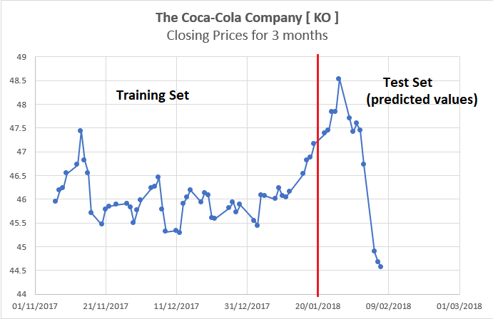
Expected Results
Applying the generalized methods of the proposed system provides us with accurate results.
The output, is a decimal number that predicts the closing price of the stock for a given day.
The error increases with the number of days in advance for which the prediction is made. The expected output for The Coca-Cola company is shown
45.7 | 46.6 | 46.8 | 47.4 | 46.7 | 46.5 | 46.2 | 46.2 | 45.9

Slide 12
Disadvantages of the Proposed System
LSSVR is computationally slower when used along with sliding-window method.
Each time the window is moved across, the LSSVR must learn for the new dataset
The LSSVR must be run each time the window slides and thus the window size affects the performance of the system
LSSVR uses many parameters that must be handled and taken care of.
The system is best suited for short term prediction and error rate increases with number of days of prediction

Slide 13
Thank You
Akshay R 1ST14CS010
Aravind B 1ST14CS023
Arun KUMAR 1ST14CS025
Ashok S 1ST14CS027
Under the guidance of
Dr. T John Peter
Sambhram Institute of Technology
Department of Computer Science & Engineering

